Slide 1
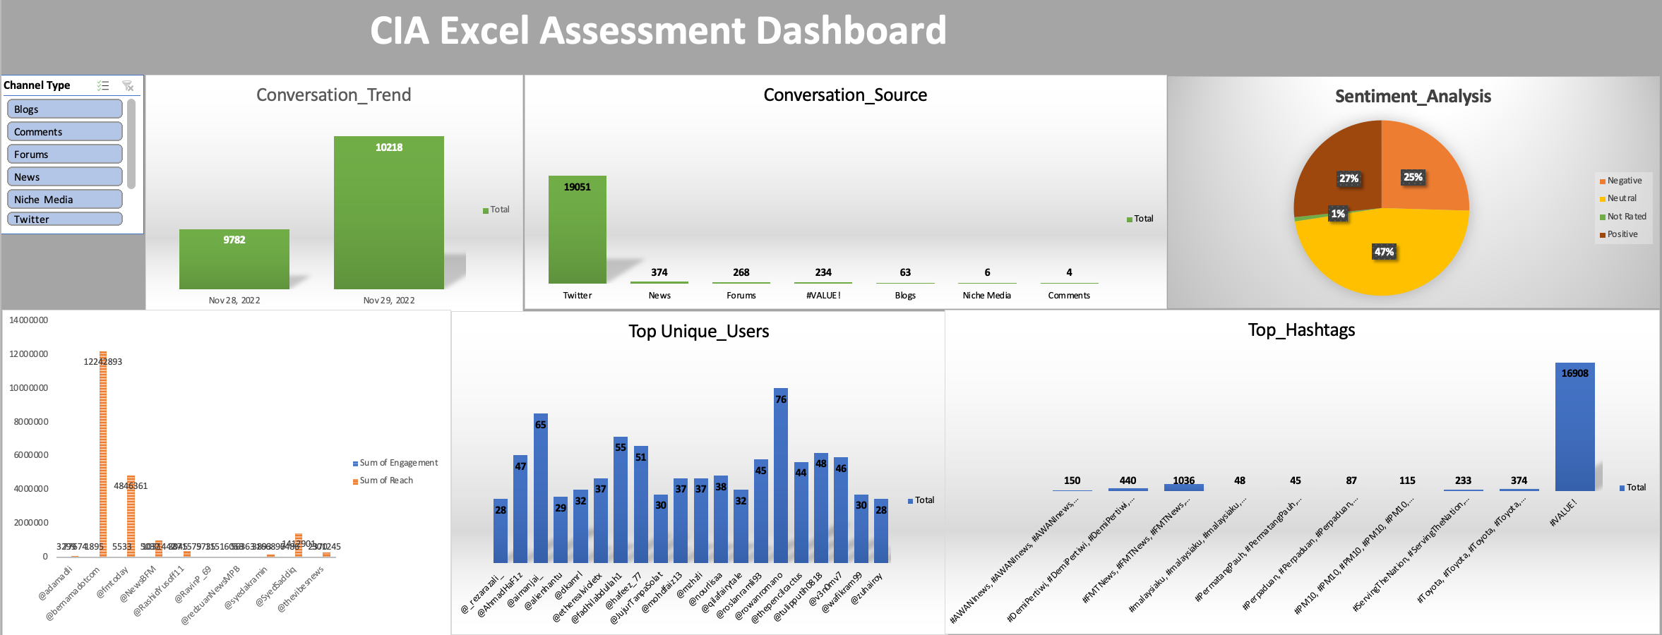
Overview of the Incident
This report analyzes online conversations to identify trends, key sources, public sentiment, top influencers, and engagement metrics. The insights will help brands and stakeholders understand audience responses and improve their strategies.

Slide 2
Key Findings
Conversation Trends
The conversation started to pick up on November 28, 2022, peaking on November 29, 2022.
The engagement tapered off gradually after the peak.

Slide 3
Key Findings
Sources of Discussion
The highest volume of discussions came from Twitter (19,051 mentions).
Other sources included News, Blogs, Forums, Niche Media, and Comments, but Twitter remained dominant.

Slide 4
Key Findings
Sentiment Analysis
47% Neutral
27% Negative
25% Positive
1% Not Rated

Slide 5
Key Findings
Top Influencers & Engagement
The most influential accounts were:
@bemamadotcom
@fmtoday
@syedsaddiq
The highest engagement was driven by a few key influencers, with the top account reaching over 12 million us

Slide 6
Key Findings
Unique Users
A total of 76 unique users generated the most discussions and on graph we only highlight the top 20 users
High levels of engagement and repeated mentions from key accounts amplified the conversation.

Slide 7
Key Findings
Hashtag Analysis
The most used hashtags were #FMTNews, #KerajaanYDPA, #MalaysiaBoleh meanwhile we couldn’t be able to analysis others due to it’s complexity in extracting the hastages.
These hashtags were widely shared across different sources, particularly Twitter.

Slide 8
Key Findings
Gender Analysis
Gender data was not available in the dataset so we are unable to proceed with it
Insights & Business Implications
Twitter dominates conversations: Brands should leverage Twitter for outreach and crisis management.
Public sentiment is divided: A nearly equal split between positive and negative sentiment suggests that brands must monitor audience responses closely.
Influencers drive engagement: Partnering with top influencers can amplify messages.
Hashtag strategy matters: Consistently using trending hashtags can increase visibility.

Slide 9
Recommendations for Brands/Stakeholders
Develop a Proactive Social Listening Strategy
Monitor real-time conversations to address concerns quickly.
Use AI-powered sentiment analysis for deeper insights.
Engage with Key Influencers
Identify and collaborate with top influencers to enhance positive brand perception.
Encourage influencer advocacy to spread key messages.
Optimize Hashtag Usage
Leverage trending hashtags to increase engagement.
Create brand-specific hashtags for consistent messaging.

Slide 10
Recommendations for Brands/Stakeholders
Enhance Crisis Management Approach
Respond swiftly to negative sentiment to prevent escalation.
Implement a dedicated response team to manage online reputation.
Expand to Other Platforms
While Twitter is dominant, explore additional platforms like Instagram, Facebook, and LinkedIn for broader reach.
Improve Data Collection for Gender Analysis
Encourage platforms to collect gender-related insights to better understand audience demographics.
Utilize survey tools or audience analytics to fill this data gap.
Prepared by: Ismail Ramadan Date: 11/02/2025

